Slide 1
Weather-based Sales Prediction:
How does Weather impact restaurant sales?
by Edwin Ng

Slide 2
Why Restaurants?
Restaurants are notorious for being one of the riskiest business ventures.
According to the National Restaurant Association, the restaurant industry has a failure rate of 30% - “in other words, 1 in 3 restaurants will not survive their first year” of business. (ToastTab)
There are many reasons why restaurants fail, including:
Difficulty acquiring and maintaining access to capital
High startup and operational costs
Lack of experience
Risk of low sales

Slide 3
It’s All About Balance
Even if factors such as experience and startup capital are accounted for, balancing costs and sales to try and turn a profit is no easy task.
Like any business, understanding clientele and how demand for your product fluctuates is crucial to maintaining said balance .
Factors that influence this behavior can be:
Long-term (ie. economic trends, competition, staffing-management, etc.)
Short-term (ie. nearby construction, local events, traffic, weather, etc.)
Long term strategy aside, restaurants need to be adaptive and dynamic in order to survive and thrive.

Slide 4
What does Weather have to do with Anything?
Restaurants are first and foremost a people business.
Weather impacts people's moods, decisions, and travel capabilities.
Weather also has an impacts on the decisions people make at restaurants.
“More than 90 percent of restaurant operators indicate that changes in local weather conditions affect their sales and customer counts.”
(Devincent-Reinbold)

Slide 5
What is the Relationship between Weather & Sales?
Knowing that weather can affect our customers' moods and decisions, how can we leverage this information to create a model that can accurately predict the sales at a restaurant given certain weather conditions?

Slide 6
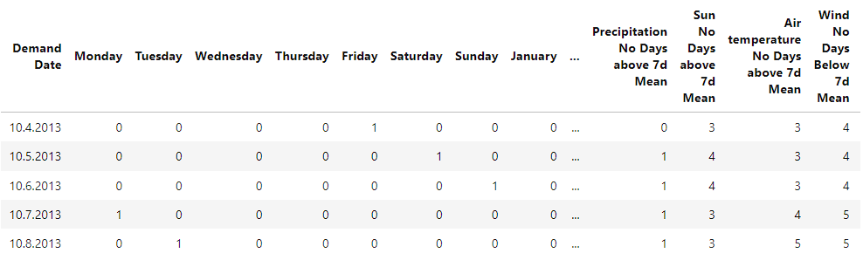
The Data:
760 rows
293 columns
Restaurant in Stuttgart, Germany.
Published November, 2019.
Data Source: https://data.mendeley.com/datasets/xv5kp6mxv7/1

Slide 7
Data Wrangling:
Original dataset was 760 rows x 293 columns.
Subset dataset to contain only relevant information (Overall/Total variable columns - removing all time period variables due to obscurity)
Data validation - ensuring all the same type of data contained within one column.
No duplicates found or null values found.
Date columns were casted to datetime64[ns] format
Final dataset was 760 rows x 40 columns.

Slide 8
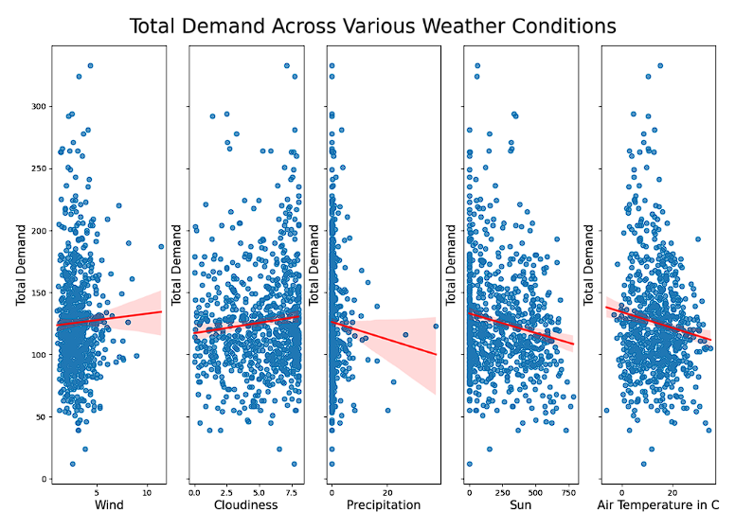
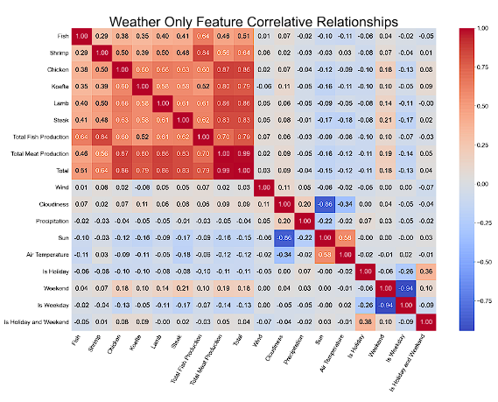
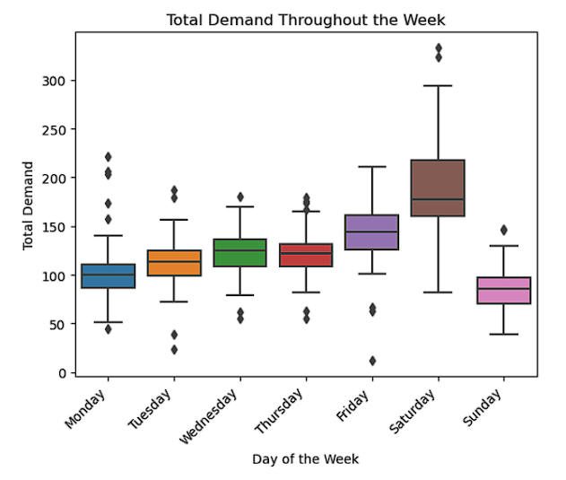
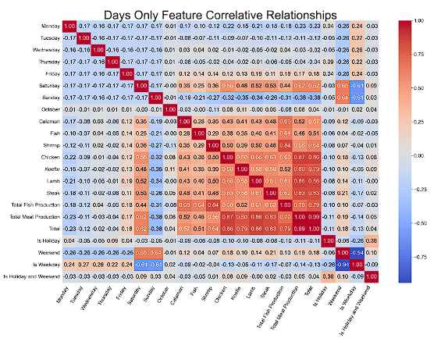
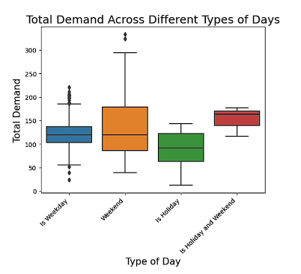
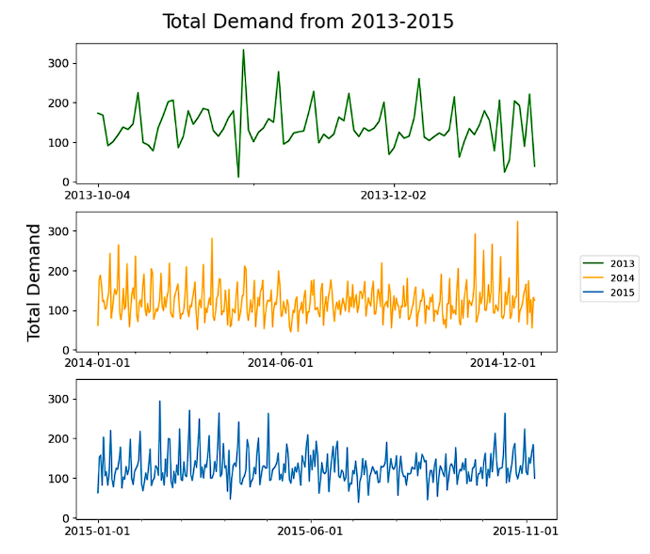
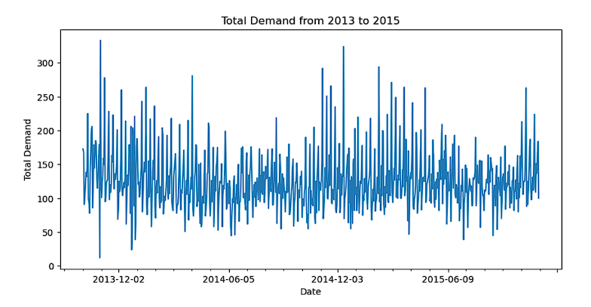
Exploratory Data Analysis:

Slide 9

Model Selection:
Linear Regression Model
Partial Least Squares Regression (PLS)
K Nearest Neighbors (KNN)
Random Forest Regression
Support Vector Regression (SVR)

Slide 10
Model Performances:
Linear Regression:
The linear regression model mean squared error: 1130.11
The linear regression model mean absolute percentage error: 325.95
34.06% accuracy with a standard deviation of 10.39
Partial Least Squares (PLS) - Number of Components = 4
The partial least squares model mean squared error: 378.40
The partial least squares model mean absolute percentage error: 293.09
34.66% accuracy with a standard deviation of 10.62
K-Nearest Neighbors - (172 Neighbors):
The KNN mean squared error: 358.40
The KNN model mean absolute percentage error: 1.86
2.43% accuracy with a standard deviation of 1.44

Slide 11
Model Performances:
Random Forest Regression Model:
Randomized Search parameters = RandomForestRegressor(max_depth=7, max_features=0.3, min_samples_leaf=2, min_samples_split=6, n_estimators=800)
The randomized search random forest regression mean squared error: 0.60
The randomized search random forest regression regression model mean absolute percentage error: 3.17
42.39 percent accuracy with a standard deviation of 10.70
Support Vector Regression (SVR):
The SVR model mean squared error is: 0.85
The SVR Model mean absolute percentage error is: 3.30
-4.66 percent accuracy with a standard deviation of 4.21

Slide 12
Model Performance Ranking:
Random Forest Regression Model with an accuracy of 42.39%
Partial Least Squares Model with an accuracy of 34.66%
Linear Regression Model with an accuracy of 34.06%
K Nearest Neighbors Model with an accuracy of 2.43%
SVR Model with an accuracy of -4.66%

Slide 13
Future Investigations:
How else could I have created stronger models given the data? What approaches are used when data is scarce to create such models?
How does weather impact other industries such as retail, entertainment, event attendance, etc.?
What impacts does location have with respect to culture?
In other words, how would this have played out given data from North America? Asia? Or the rest of Europe?

Slide 14
Thank You!
Special Thanks to:
Mendeley Data for hosting and creating public access to datasets like these.
David Lara-Arango for mentoring throughout this project
Julius-Maximilians-Universitat Wurzburg as the original source of the study.

